Slide 1
BJT Circuits At DC
Reference: Sedra & Smith Microelectronic Circuits

Slide 2
Answers to some questions
Why don’t we use reverse active mode? Can emitter and collector be interchanged for a BJT?
We use VCEsat=0.2V(for npn). Why Threshold voltage for B-E junction is 0.7V, but threshold voltage for C-B junction is smaller(0.4-0.5V)?
Why do we use VCEsat = 0.2V(for npn) in saturation mode?

Slide 3
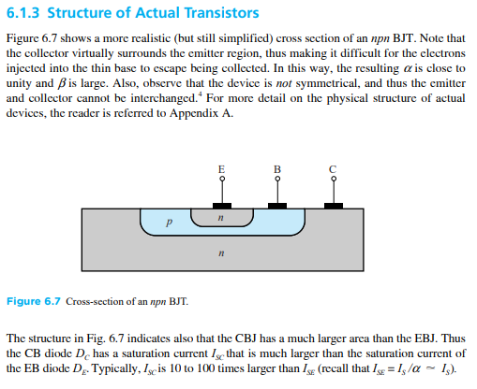
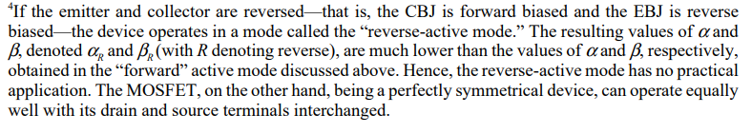
Find the answers here

Slide 4
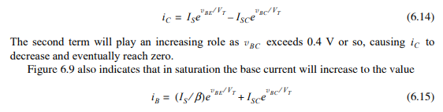
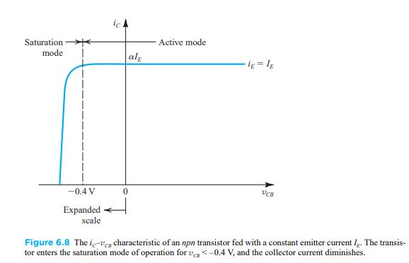
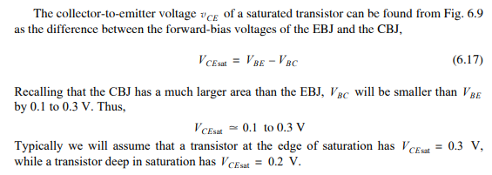
Find the answers here

Slide 5
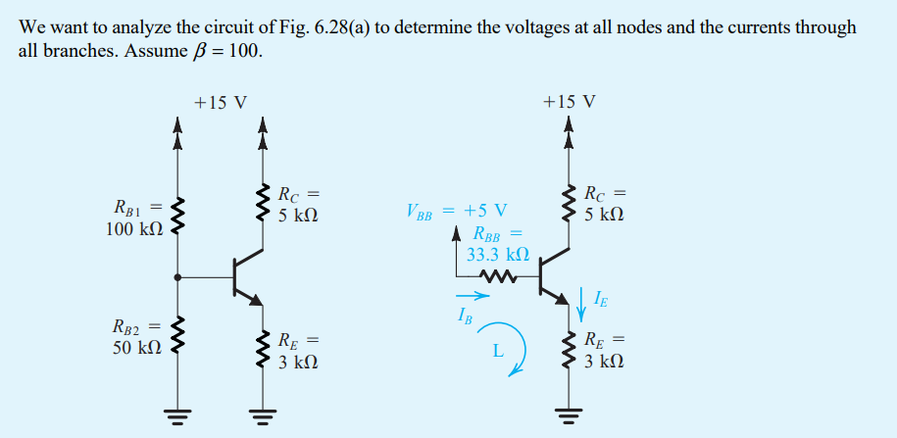
Problem 1

Slide 6
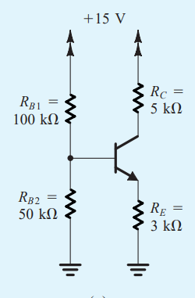

Slide 7
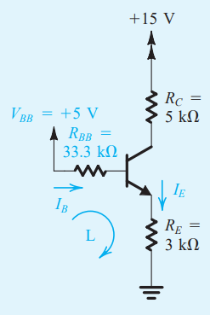

Slide 9
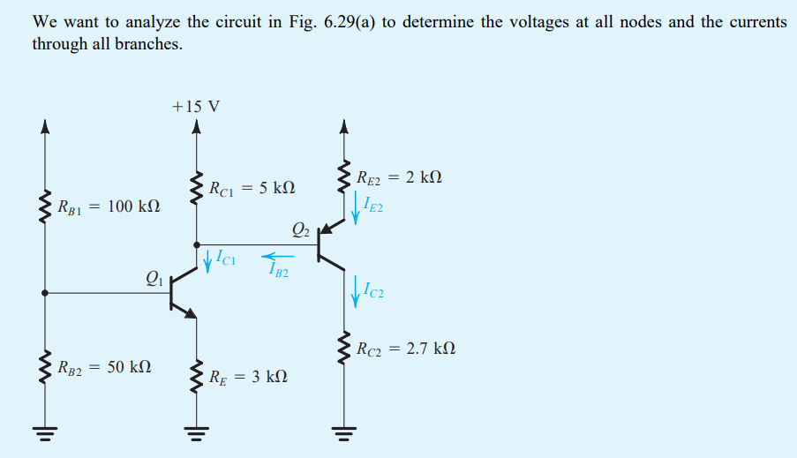
Problem 2

Slide 10
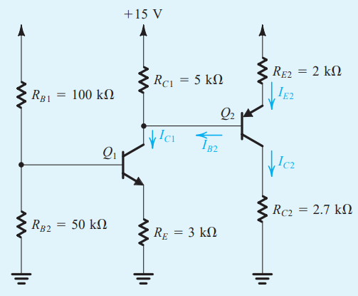
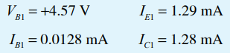

Slide 14
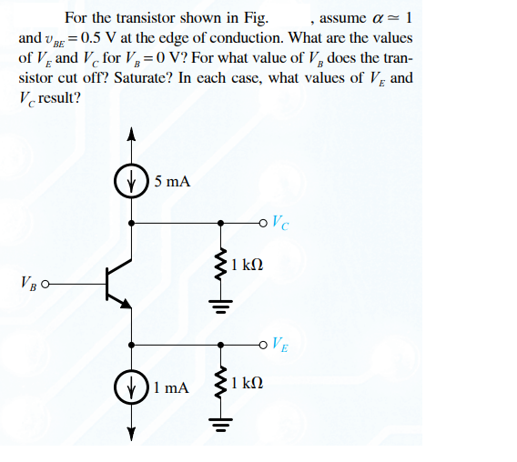
Exercise

